Slide 1



Analyzing Air Quality in EU Capitals
Big Blue Academy
Data Engineering Bootcamp
June 2024

Slide 2
TABLE OF CONTENTS
01
02
03
04
05
Team Presentation
Project Overview
Solution Approach
Summary
Future Actions

Slide 3



01 Team Presentation
LENA LIOSI
ALEXANDRA ARSENI
FRAGKOULIS PSATHAS
Mech Eng@NTUA
Operations Spv in Manufacturing
ECE@NTUA
Junior Data Engineer
Mech Eng@NTUA
Researcher and PhD candidate@NTUA

Slide 4
02 Project Overview
PROJECT SCOPE
PROJECT GOALS
Construct a data pipeline that aggregates air quality data from EU capitals and checks compliance with EU Air Quality standards
Project Goals:
Inform citizens with continuous and visual insights about Air Quality metrics in EU and their compliance according to EU standards
Correlate factors such as GDP, life expectancy and weather data to Air Quality metrics

Slide 5
Key terms regarding project
AIR QUALITY INDEX (AQI)
COMMON POLLUTANTS
An indicator developed by government agencies to communicate to the public how polluted the air currently is or how polluted it is forecast to become
Ground-level ozone, particle pollution (also known as particulate matter), carbon monoxide, sulfur dioxide, and nitrogen dioxide.
EU limits
OTHER FACTORS
EU air quality standards vary by pollutant and exposure time, with legally binding limit values and less strict target values.
The relationships between weather, GDP per capita, age, and air pollution need to be examined to understand their impacts.

Slide 6
03 Solution Approach
SOLUTION
PREREQUISITES
Develop a database that stores Air Pollution , Weather Data and Country-specific information.
Automate the ETL process
Enable users to access data through an intuitive interface
Visualize key user questions

Slide 7












Process Pipeline
APIs
Tools and Technologies
Base

Slide 8


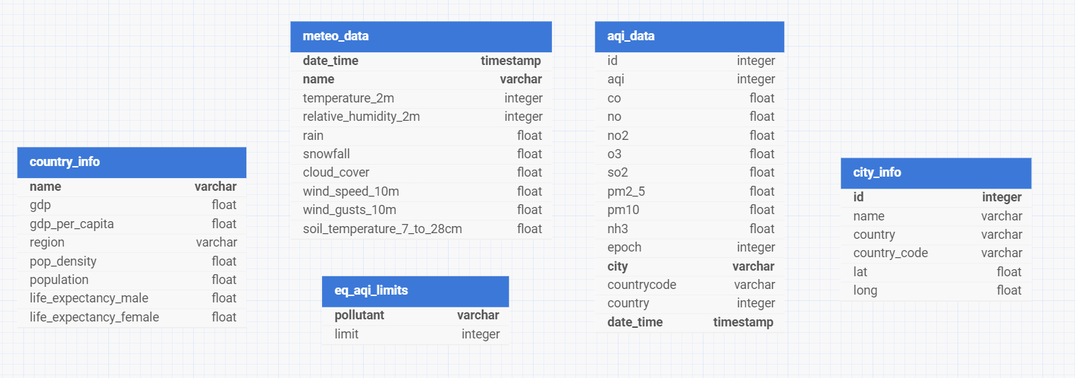
Database Tables

Slide 9
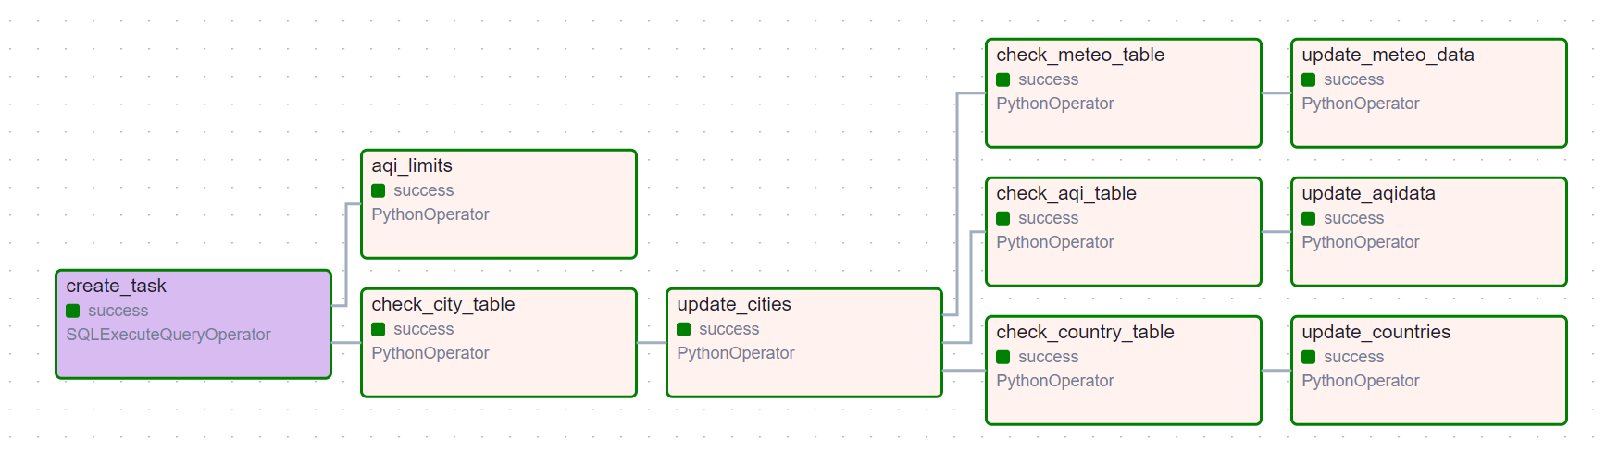
Airflow Pipeline

Slide 10


Discord Notifications

Slide 11
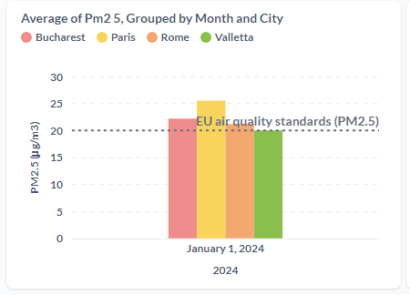
Metabase Dashboard -
Capitals exceeding EU standards for PM2.5
Easy monitoring
Focused action on policies

Slide 12
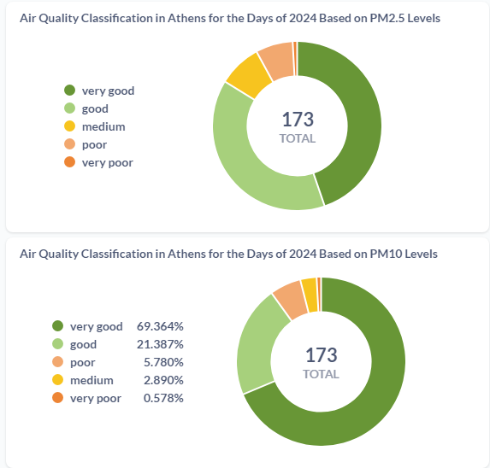

Metabase Dashboard -
Air quality classification based on different pollutants

Slide 13
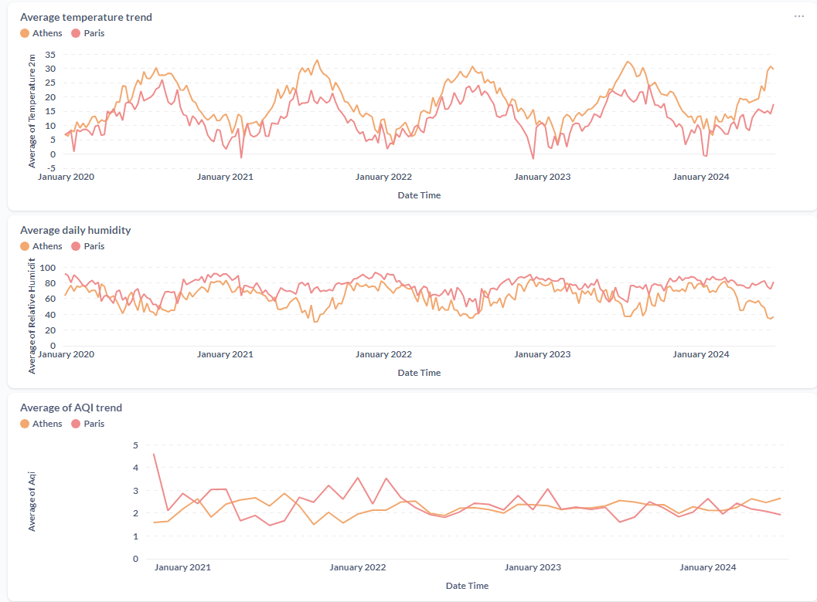
Metabase Dashboard -
Aqi, temperature and humidity trends

Slide 14
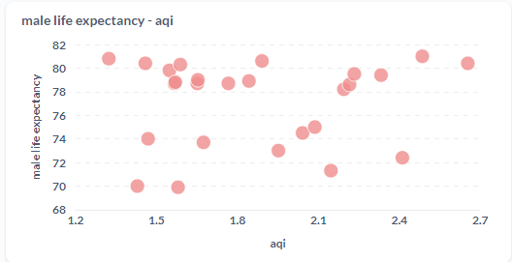
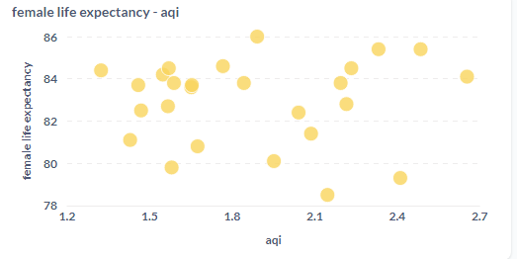
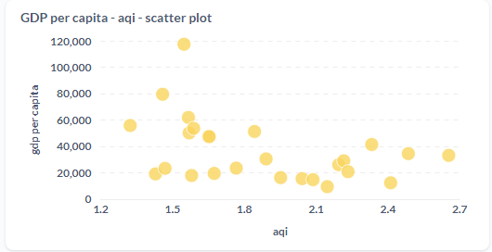
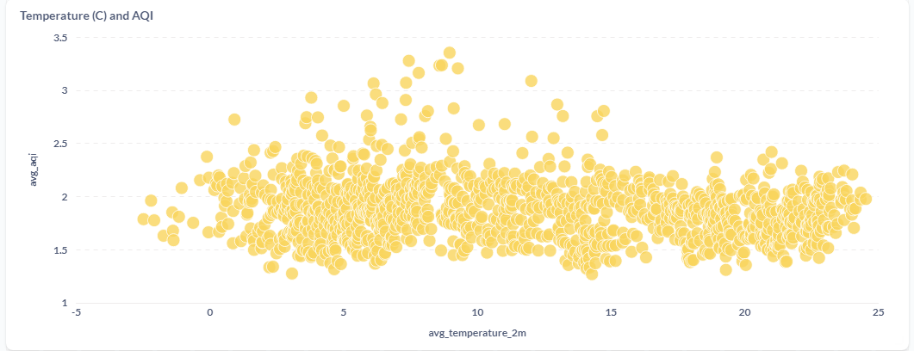
Metabase Dashboard -
Correlation of air quality with life expectancy, gdp and temperature

Slide 15
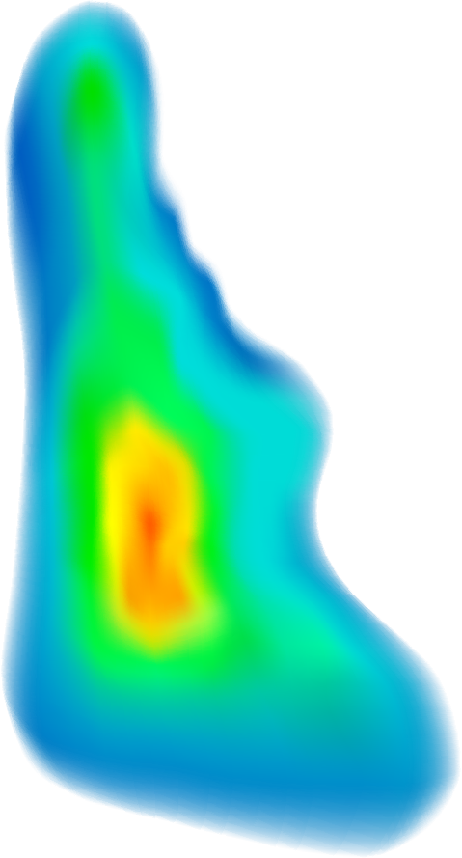


04 Summary
The EU can readily identify capital cities not complying with Air Quality standards.
A potential correlation between GDP per capita and Air Quality exists, but further data is needed to confirm this relationship.
Further data needed to correlate temperature and air quality
Key pollutants found: PM2.5, PM10 and O3

Slide 16
05 Future actions
Gather more data globally to better correlate air quality with gdp per capita, temperature and life expectancy
Perform spatial analysis in more EU cities
Develop an application for better monitoring and predictive analytics of air quality for actionable insights

Slide 17
Find our project here!
Gitlab url

Slide 18



THANKS!
LENA LIOSI
ALEXANDRA ARSENI
FRAGKOULIS PSATHAS

